Slide 1
Honey Badger Algorithm
Metaheuristics for Search & Optimization
Sumit
Anto

Slide 2
Overview
Select a template paper/recent metaheuristic continuous optimization algorithm:
Honey Badger Algorithm
Implement in Julia and Benchmark against the template paper
Adapt the algorithm to solve the symmetric TSP problem and benchmark the algorithm
Generate a TSP Art using the modified algorithm

Slide 3
Paper Details
Title: Honey Badger Algorithm: New metaheuristic algorithm for solving optimization problems
Authors: Fatma A. Hashim, Essam H. Houssein, Kashif Hussain, Mai S. Mabrouk, Walid Al-Atabany
Published on: Feb 2022
Citations: 176
PDF: https://sigmaland.ir/wp-content/uploads/2022/01/Sigmaland-Honey-Badger-Algorithm-New-metaheuristic-algorithm-for-solving-optimization-problems.pdf

Slide 4
Mathematical Model & Algorithm Steps
Initialization Phase
Defining Intensity (I)
Density Factor
Escaping from local optimum
Updating the agent’s positions
Digging Phase
Honey Phase

Slide 5
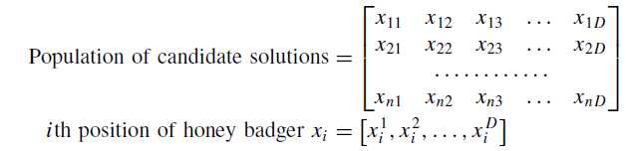
Initialization Phase
Initialize the number of honey badgers (population size N) and their respective positions based on eq:
xi = lbi + r1 × (ubi − lbi ), r1 is a random number between 0 and 1 (1)
where xi is ith honey badger position referring to a candidate solution in a population of N, while lbi and ubi are respectively lower and upper bounds of the search domain.

Slide 6
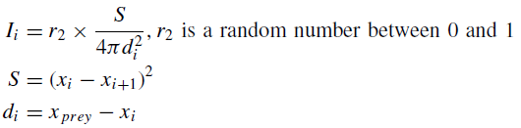
Defining Intensity (I)
Intensity is related to concentration strength of the prey and distance between it and ith honey badger
If the smell is high, the motion will be fast and vice versa, is given by Inverse Square Law
where S is source strength or concentration strength & di denotes distance between prey and the ith badger.

Slide 7
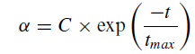
Update density factor
The density factor (α) controls time-varying randomization to ensure smooth transition from exploration to exploitation
Update decreasing factor α that decreases with iterations to decrease randomization with time, using Eq.:
where C is a constant ≥ 1 (default = 2) & tmax = maximum number of iterations.

Slide 8
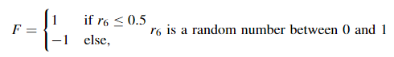
Other key parameters
Xprey - best candidate solution so far
Fprey - fitness value of the best solution
The proposed algorithm uses a flag F which alters search direction for availing high opportunities for agents to scan the search-space rigorously
Beta (β) ≥ 1 (default = 6) is ability of the honey badger to get food.

Slide 9
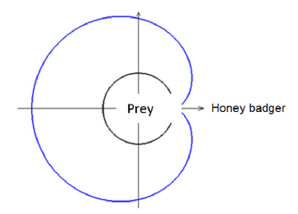
Updating agent’s position: Digging Phase
In digging phase, a honey badger performs action similar to Cardioid Motion which can be simulated by equation
Here, a honey badger heavily relies on smell intensity I of prey Xprey , distance between the badger and prey di , and time-varying search influence factor α.
Moreover, during digging activity, a badger may receive any disturbance F which allows it to find even better prey location.
Fig.: blue outline is smell intensity, black circular line shows prey location.

Slide 10
Updating agent’s position: Honey Phase
The case when a honey badger follows honey guide bird to reach beehive can be simulated as equation
It can be observed that a honey badger performs search close to prey location xprey found so far, based on distance information di .
At this stage, the search is influenced by search behavior varying by time (α).
Moreover, a honey badger may find disturbance F.

Slide 11
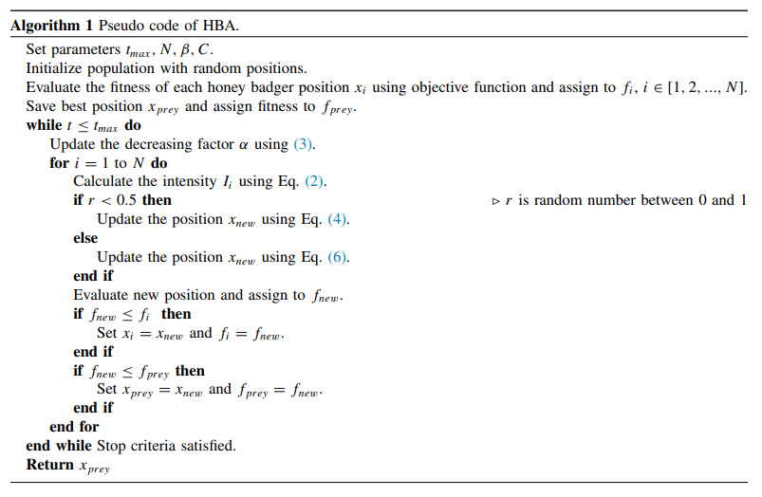
HBA: Algorithm

Slide 12
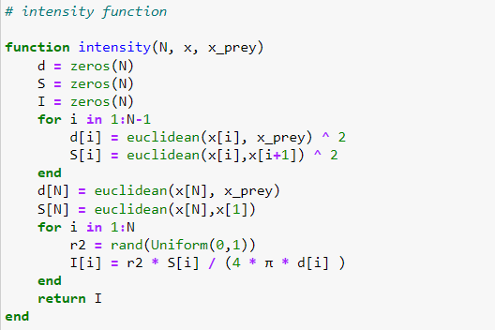
Julia Implementation (1/6)

Slide 13
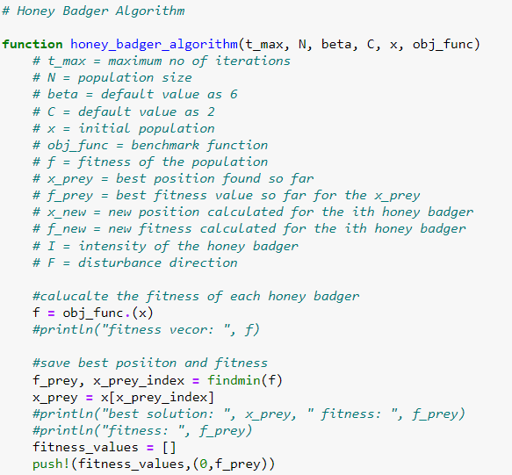
Julia Implementation (2/6)

Slide 14
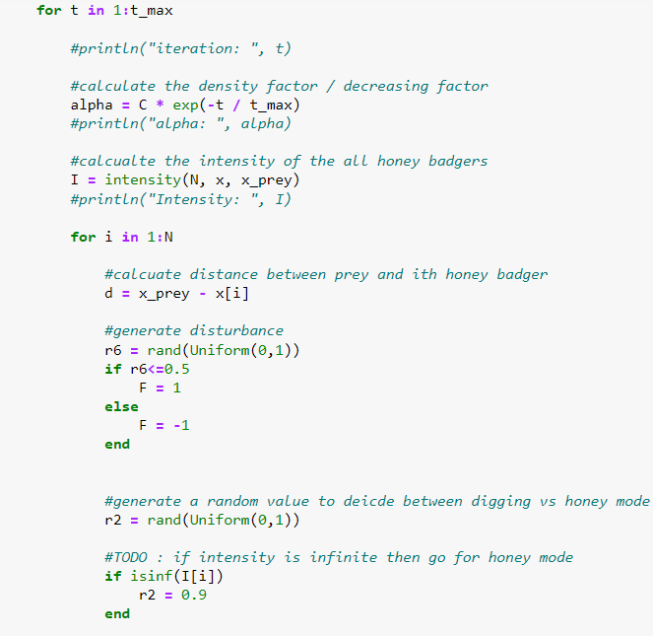
Julia Implementation (3/6)

Slide 15
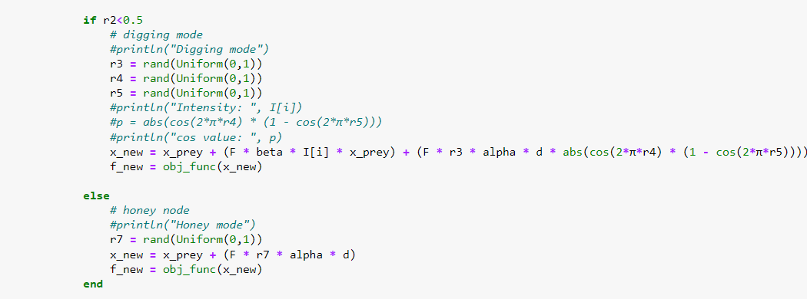
Julia Implementation (4/6)

Slide 16
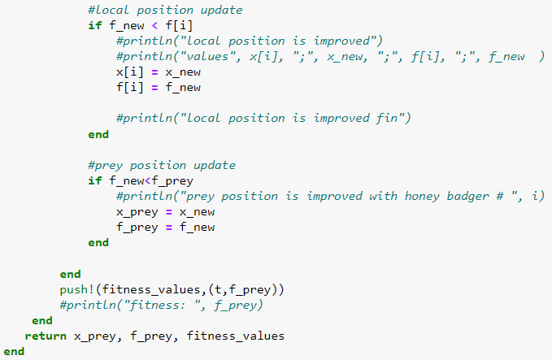
Julia Implementation (5/6)

Slide 17
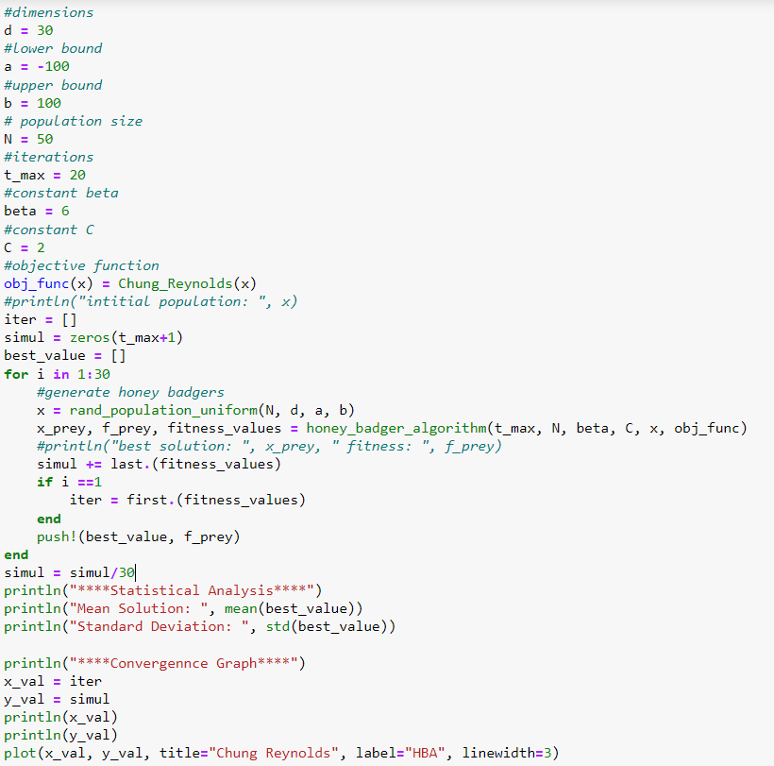
Julia Implementation (6/6)

Slide 18
Experimental Section
24 - Standard Benchmark Functions
Statistical Analysis
Convergence Analysis

Slide 19
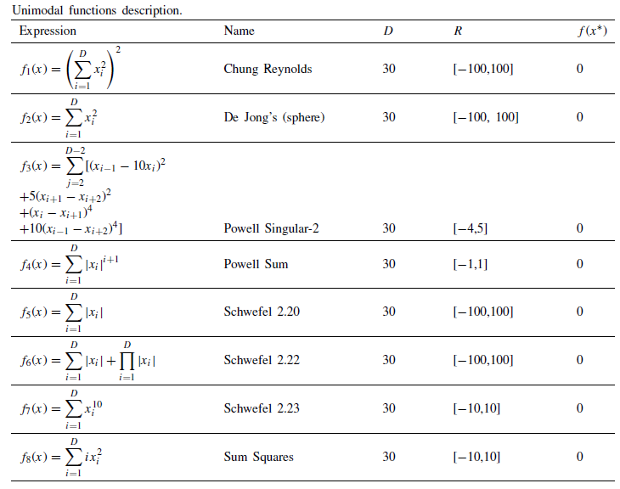
Benchmark Function: Unimodal
Parameter Settings:
N = 50
T-_max = 1000
Simulation = 30
Case:1 Dimension = 30
Case:2 Dimension = 50

Slide 20
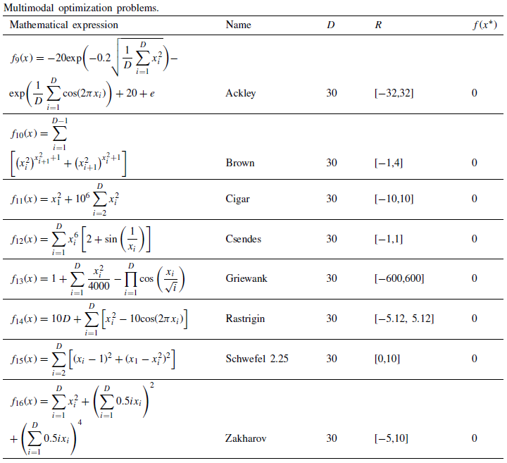
Benchmark Function: Multimodal
Parameter Settings:
N = 50
T-_max = 1000
Simulation = 30
Case:1 Dimension = 30
Case:2 Dimension = 50

Slide 21
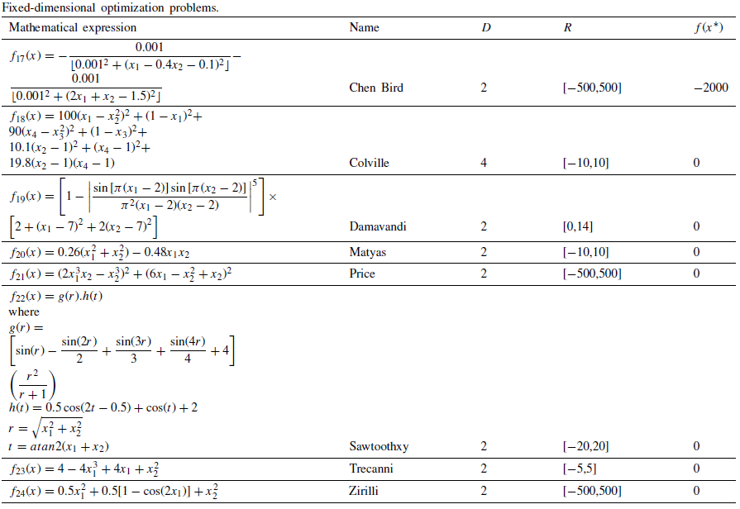
Benchmark Function: Fixed Dimension
Parameter Settings:
N = 50
T_max = 1000
Simulation = 30
Dimension : Fixed dimensions (different)

Slide 22
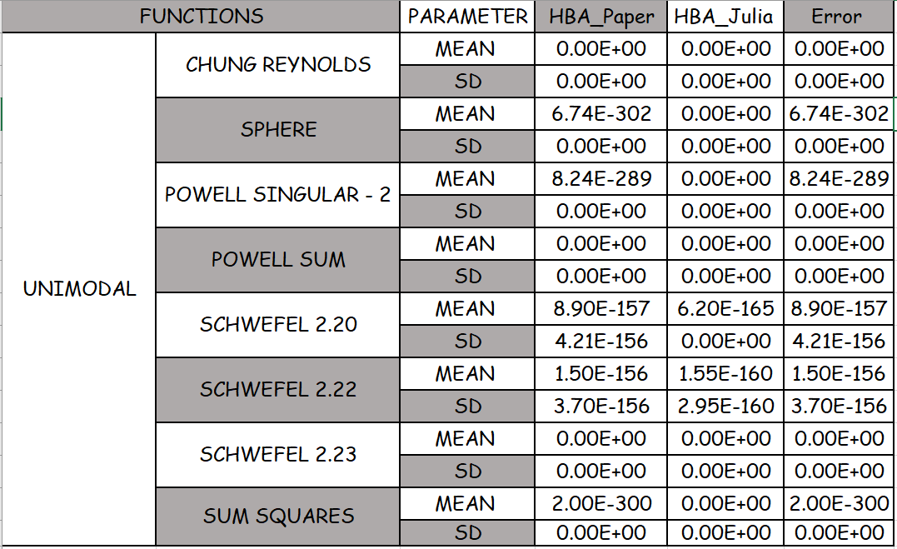
Statistical Analysis (1/3)
The statistical results show robustness of the proposed HBA algorithm. Here, we compare our results against the paper.

Slide 23
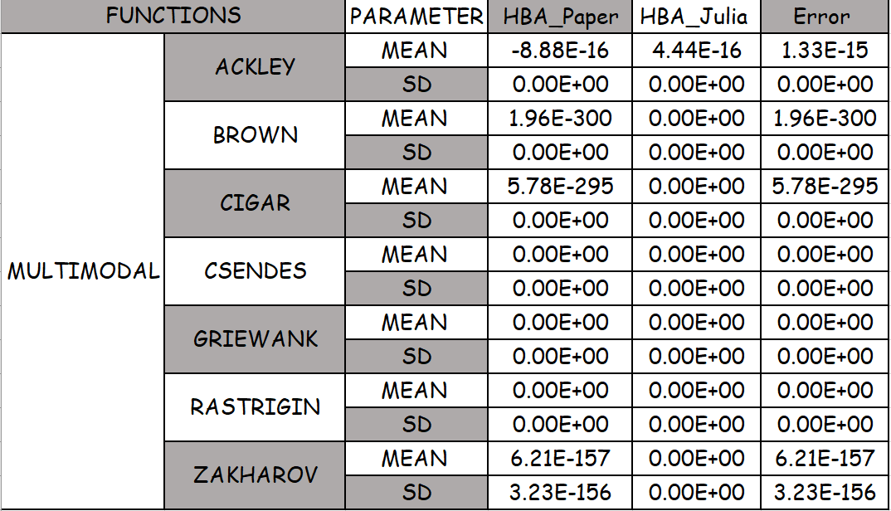
Statistical Analysis (2/3)
The statistical results show robustness of the proposed HBA algorithm. Here, we compare our results against the paper.

Slide 24
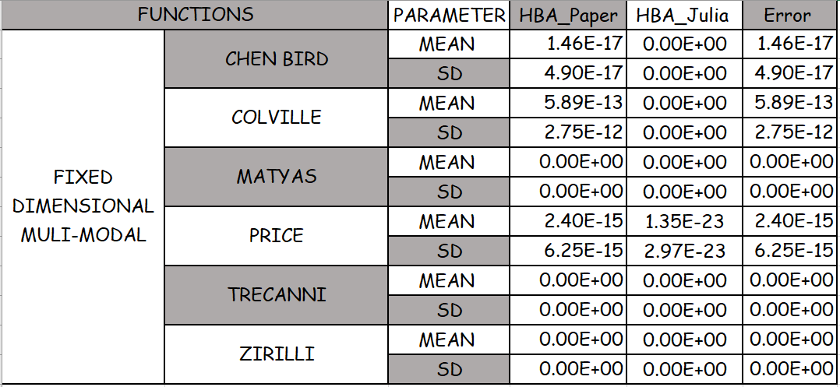
Statistical Analysis (3/3)
The statistical results show robustness of the proposed HBA algorithm. Here, we compare our results against the paper.

Slide 25
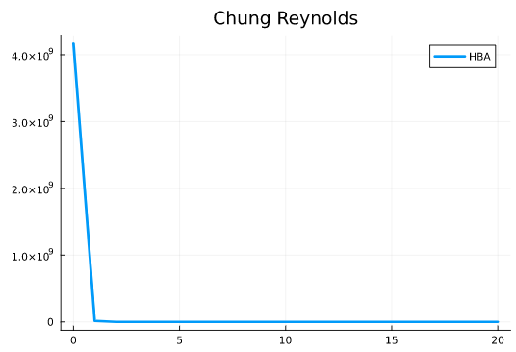
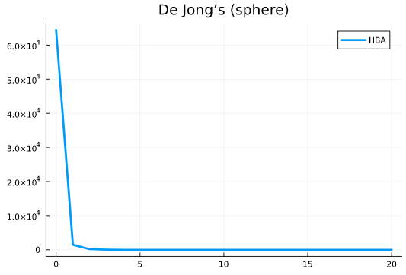
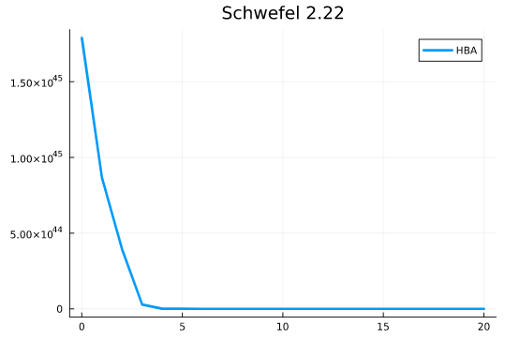
Convergence Analysis (1/8)
Convergence graphs shows how efficiently the algorithm progressed during the course of search process

Slide 26
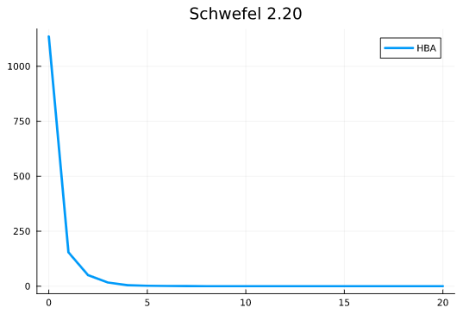
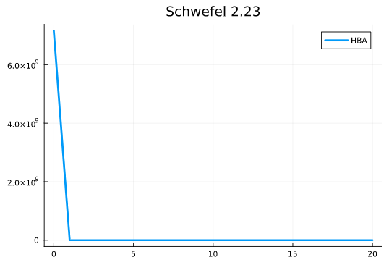
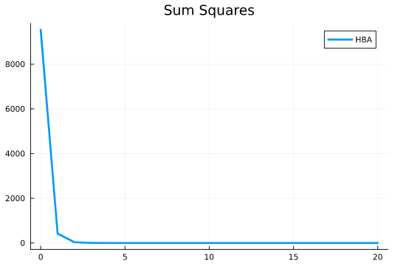
Convergence Analysis (2/8)
Convergence graphs shows how efficiently the algorithm progressed during the course of search process

Slide 27
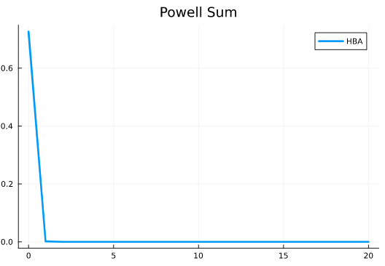
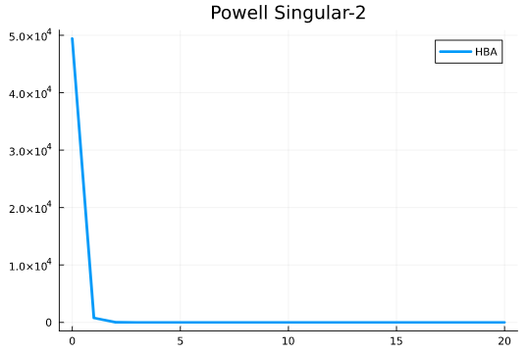
Convergence Analysis (3/8)
Convergence graphs shows how efficiently the algorithm progressed during the course of search process

Slide 28
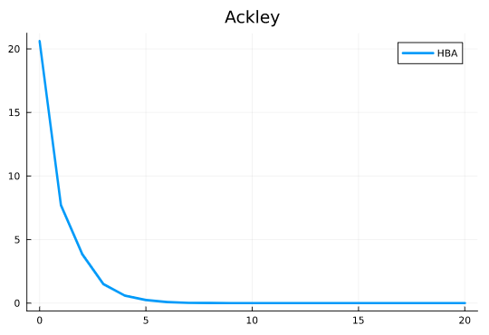
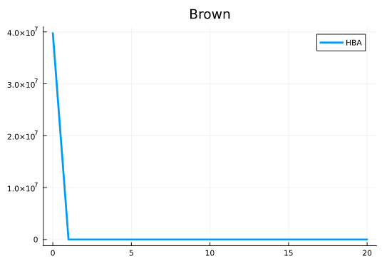
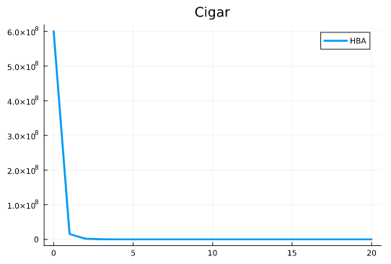
Convergence Analysis (4/8)
Convergence graphs shows how efficiently the algorithm progressed during the course of search process

Slide 29
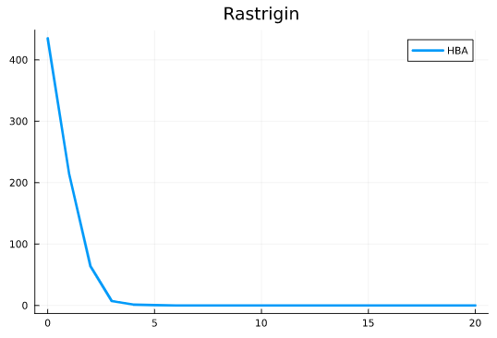
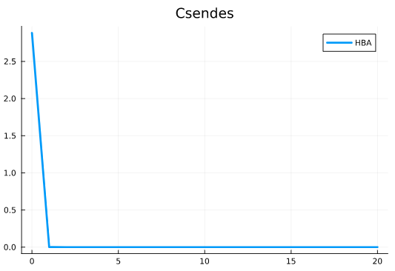
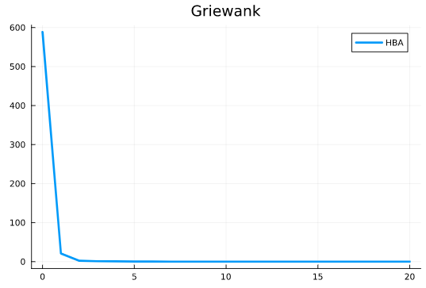
Convergence Analysis (5/8)
Convergence graphs shows how efficiently the algorithm progressed during the course of search process

Slide 30
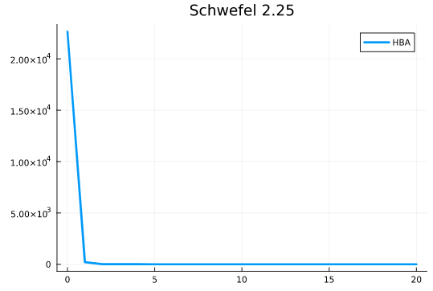
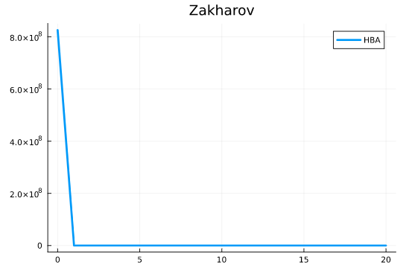
Convergence Analysis (6/8)
Convergence graphs shows how efficiently the algorithm progressed during the course of search process

Slide 31
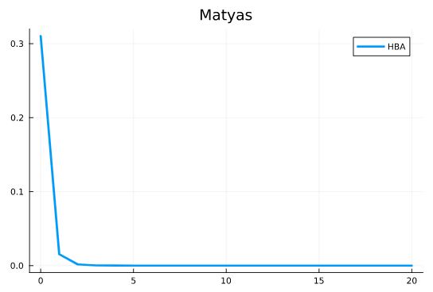
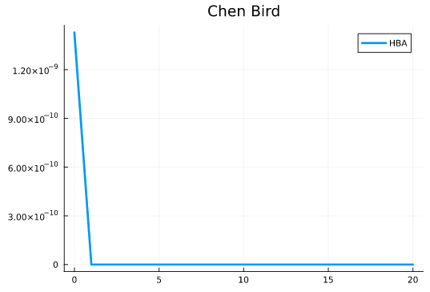
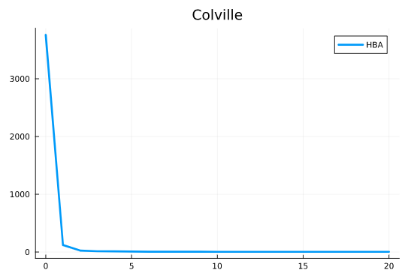
Convergence Analysis (7/8)
Convergence graphs shows how efficiently the algorithm progressed during the course of search process

Slide 32
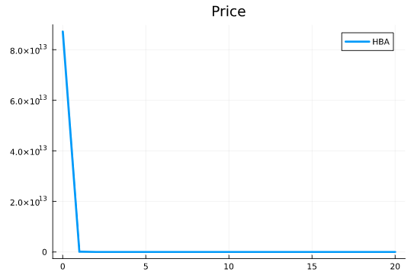
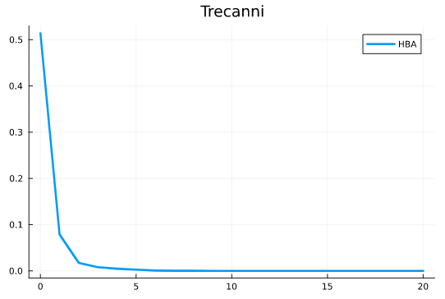
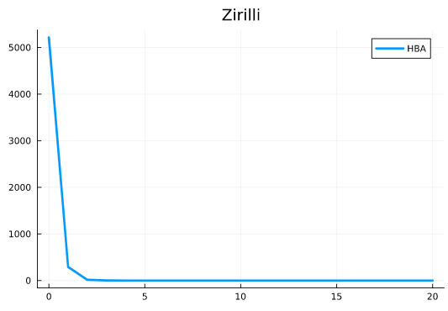
Convergence Analysis (8/8)
Convergence graphs shows how efficiently the algorithm progressed during the course of search process

Slide 33
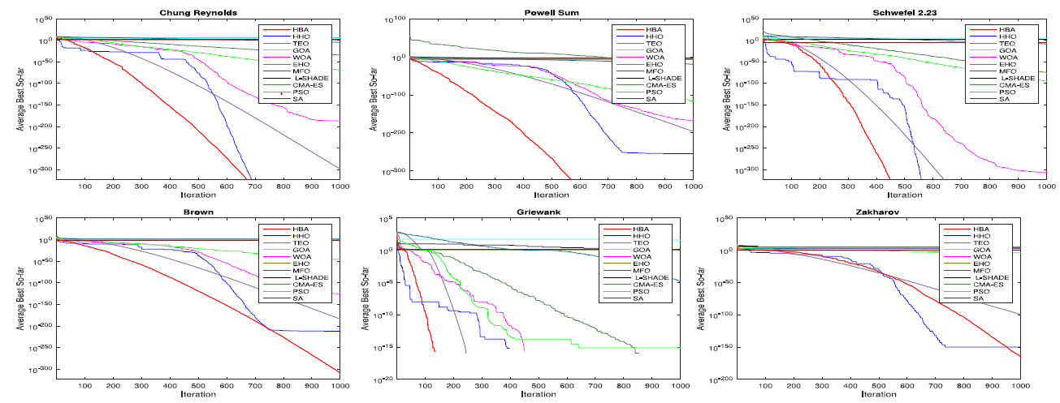
Convergence Analysis Comparison (1/2)
Convergence graphs shows how efficiently the algorithm progressed during the course of search process

Slide 34
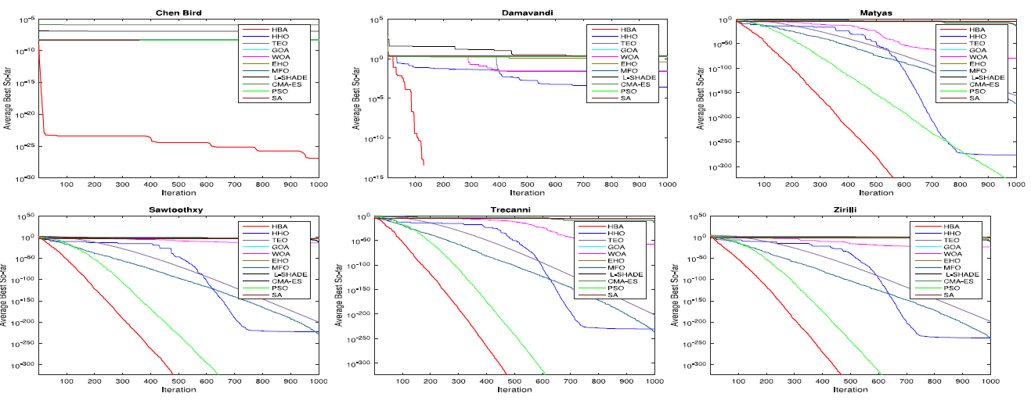
Convergence Analysis Comparison (2/2)
Convergence graphs shows how efficiently the algorithm progressed during the course of search process

Slide 35
TSP Adaptation of HBA
The HBA is designed to solve continuous optimization problems. We have modified the HBA to solve the combinatorial problem TSP
A major focus here was to preserve the original equations of HBA which makes it unique.
But these equations generate a solution in continuous domain.
The idea is to generate a tour based on the solution generated by the HBA and the distance matrix. Furthermore, then evaluate its fitness/cost/length of tour.
Key ideas:
# of dimensions = # of cities in TSP
X_new is thought of as probability of selecting the city at the index
First city is selected as the index of the dimension of X_new with lowest value
Next city is selected after calculating the probability distribution using X_new[i] * (1 / d[LastCity, i] )

Slide 36
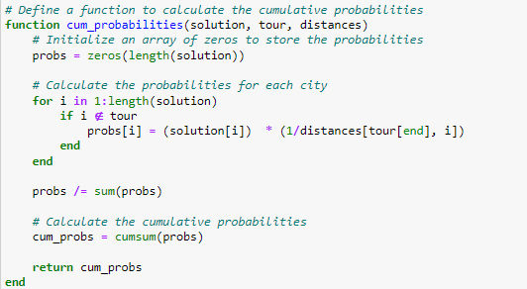
TSB Julia Implementation (1/3)

Slide 37
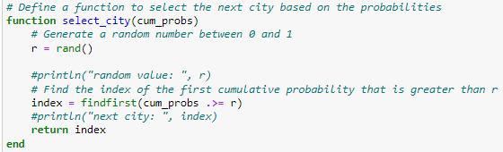
TSB Julia Implementation (2/3)

Slide 38
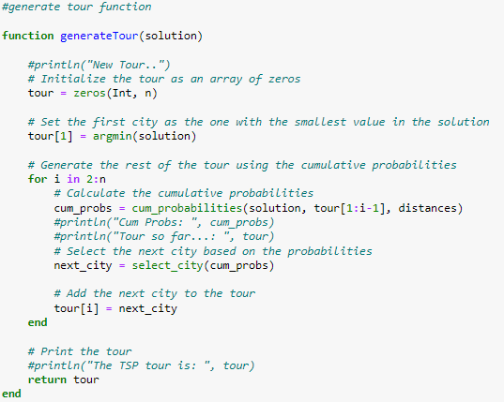
TSB Julia Implementation (3/3)

Slide 39
TSP Benchmark
Template Paper
Safaa Bouzidi and Mohammed Essaid Riffi. 2017. Discrete swallow swarm optimization algorithm for travelling salesman problem. In Proceedings of the 2017 International Conference on Smart Digital Environment (ICSDE '17). Association for Computing Machinery, New York, NY, USA, 80–84. https://doi.org/10.1145/3128128.3128141
TSPLIB functions
14 city in Burma
52 locations in Berlin (Groetschel)
101-city problem (Christofides/Eilon)
VLSI Dataset
662-city problem (xql662)
1380 city problem (bcl1380)

Slide 40
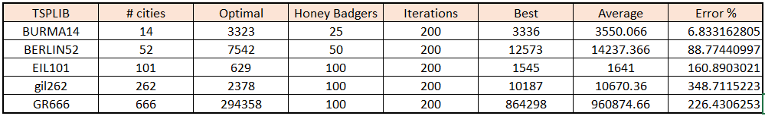
TSP Benchmark Table

Slide 41
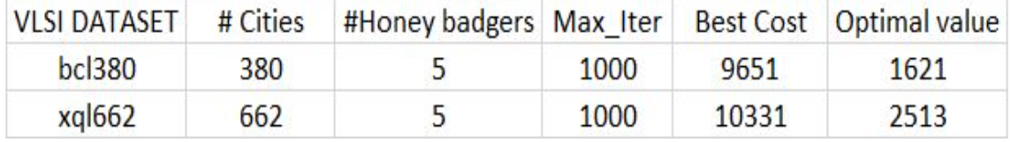
TSP Benchmark Table

Slide 42
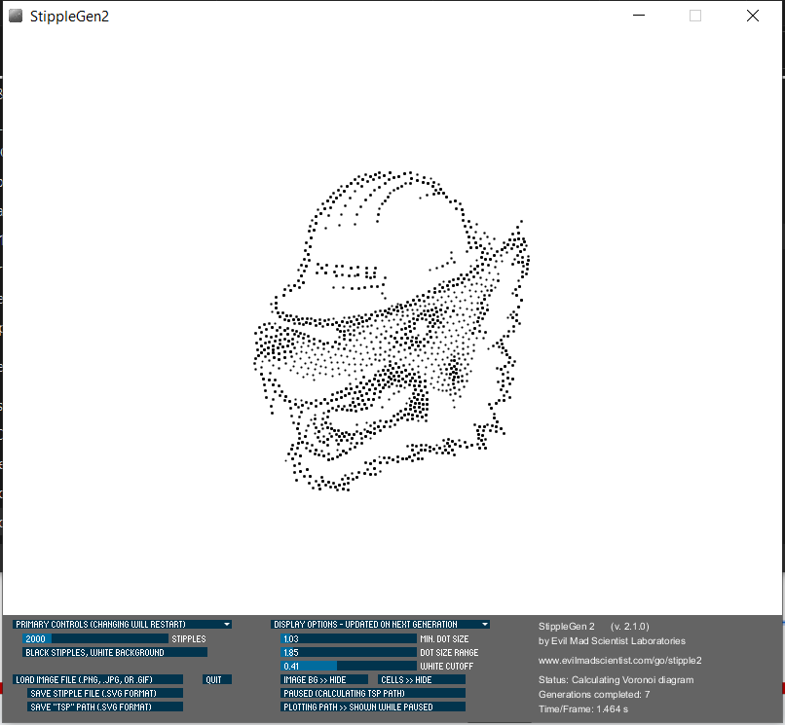


TSP Art
Image
Stipple JPG to SVG
SVG to TSP

Slide 43
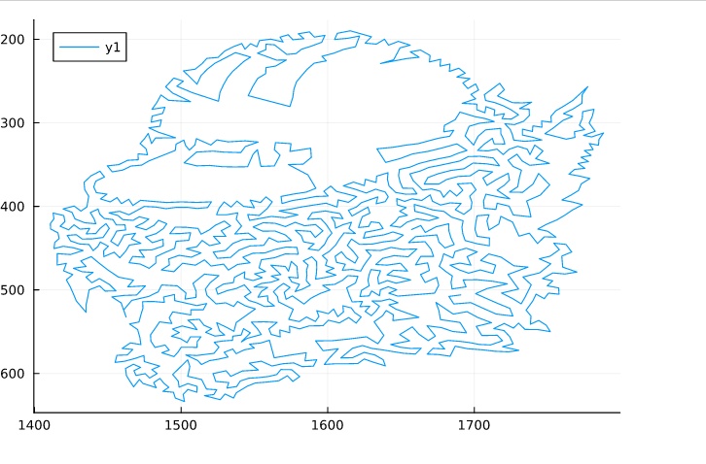
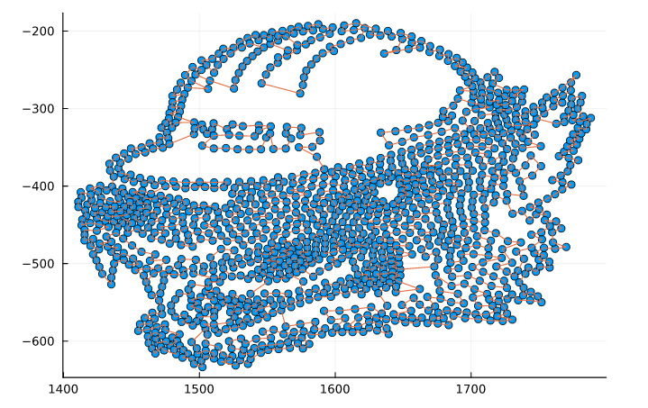
1373 points: #HB = 5 and Iteration = 10

Slide 44


TSP 3D-PRINT

Slide 45






FEW MORE WORKS:

Slide 46

Future Work: 3D TSP Art - Additional Idea
3D TSP ART :
Our goal is to use convert our Julia implementation of TSP-HBA into a Python script that can generate a 3D TSP Art of a chosen 3D mesh or object in Blender 3D.
Source: Example of Blender suzanne 3D TSP using 2-OPT algorithm http://www.voidgoat.com/blogs/3d-tsp/

